Slide 1
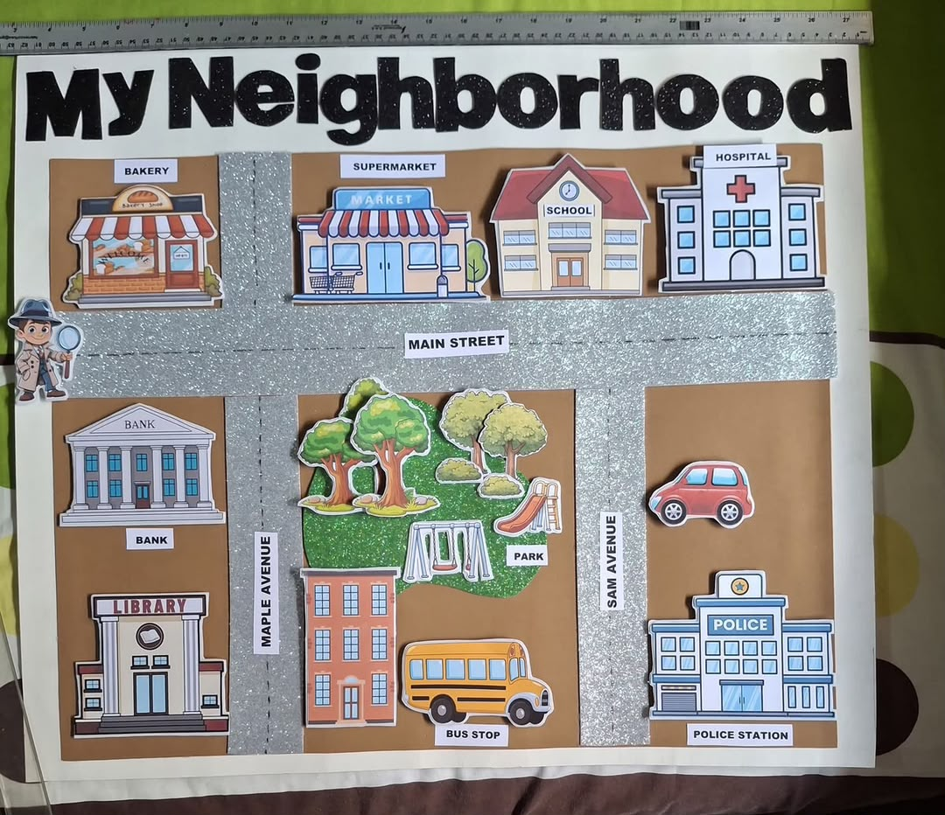
THE CODING CLUBHOUSE
Animation
and
Collaboration
DAY 4
DREAM BEYOND LIMITS

Slide 2



RECAP · DAY 3
Let's Remember Conditionals
IF → THEN
ENERGISER: "If I'm a..."
A conditional checks something first.
TRUE → the action happens.
FALSE → the action skips.
If I'm a cat → I pounce.
If I'm a robot → I spin.
If I'm a lion → I roar.
Cat → Pounce
Robot → Spin
Lion → Roar
DAY 4 · ANIMATION & COLLABORATION
2

Slide 3
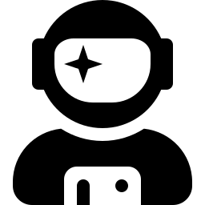

MINI LESSON
What Is Animation?
Animation is something changing over time.
FRAME 1
FRAME 2
FRAME 3
Standing still
Mid-movement
New position
Nothing moves until something happens.
A key press, a click, or a timer is an event.
DAY 4 · ANIMATION & COLLABORATION
3

Slide 4


KEY CONCEPT
Animation = Events + Actions
EVENT
ACTION
RESULT
Button pressed
Code runs
Character moves
Nothing happens without an event.
One event can trigger many actions.
This is how every animation works.
DAY 4 · ANIMATION & COLLABORATION
4

Slide 5


ACTIVITY
Blockly Story Animator
Press a button. Watch your code come to life.
Events
Move
Speak
Look
Sound
FOUR LEVELS, GROWING EACH TIME
1
2
3
4
Move Left & Right
Add Speak & Look
Add Scene Change
Free Mode!
DAY 4 · ANIMATION & COLLABORATION
5

Slide 6
ACTIVITY
Blockly Story Animator
EXAMPLE: a finished team project
Each part is clearly labeled and laid out. Your Story Animator screen works the same way — labeled buttons and blocks, organized so anyone can follow along.
DAY 4 · ANIMATION & COLLABORATION
5

Slide 7


ACTIVITY
Build Your Character
Give your character a look, a voice, and a move.
Voice
What they say
Costume
Movement
Pick a look
How they move
Choose a costume that fits your story.
Decide what your character says and when.
Pick movements that show personality.
DAY 4 · ANIMATION & COLLABORATION
6

Slide 8
CHALLENGE
Character Change Challenge
Every great story changes its character.
START
END
What does your character look like at the start?
EVENT
What does your character look like at the end?
Talk with your team: what event causes your character to change?
That event becomes the button that triggers it in your animation.
DAY 4 · ANIMATION & COLLABORATION
7

Slide 9

TEAM PROJECT
Storyboard Planning
Plan your story across 3 panels with your team.
BEGINNING
MIDDLE
END
Setting & character
What event happens?
How does it end?
+ caption + event label
+ caption + event label
+ caption + event label
Draw the setting, characters, and action.
Write a caption for each panel.
Label the event that moves the story forward.
DAY 4 · ANIMATION & COLLABORATION
8

Slide 10

TEAM PROJECT
Character Cutouts
Bring your characters into the real world.
Your cutout should:
ON SHOWCASE DAY
Be recognizable as your character.
Be large enough to hold and move.
Have its name written on the back.
One holds the panel. One moves the character. The story comes alive.
DAY 4 · ANIMATION & COLLABORATION
9

Slide 11

WRAP UP
Reflection & Badge
THINK ABOUT TODAY
BADGE OF THE DAY
Where does your character start, and end?
What event changes everything in your story?
Creative Coder
Completed Levels 1–2 of Story Animator
Found the event that changes my character
Started my storyboard & character cutout
How did your team work together today?
DAY 4 · ANIMATION & COLLABORATION
10

